Slide 1

DNA: The Chemical Nature of the Gene
Prepared by
Dr. Rawa Abdul Redha Aziz
Ph.D Antibiotics/ Molecular biology
Dr. Hiba Shakir Ahmed
Ph.D Microbiology/Immunity

Slide 2
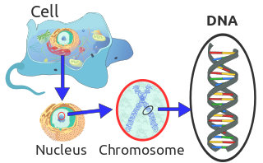
Deoxyribonucleic acid (DNA)
is a thread-like chain of nucleotides carrying the genetic instructions used in the growth, development, functioning and reproduction of all known living organisms and many viruses

Slide 3
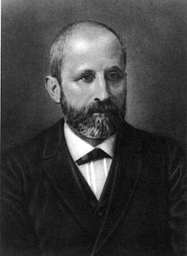
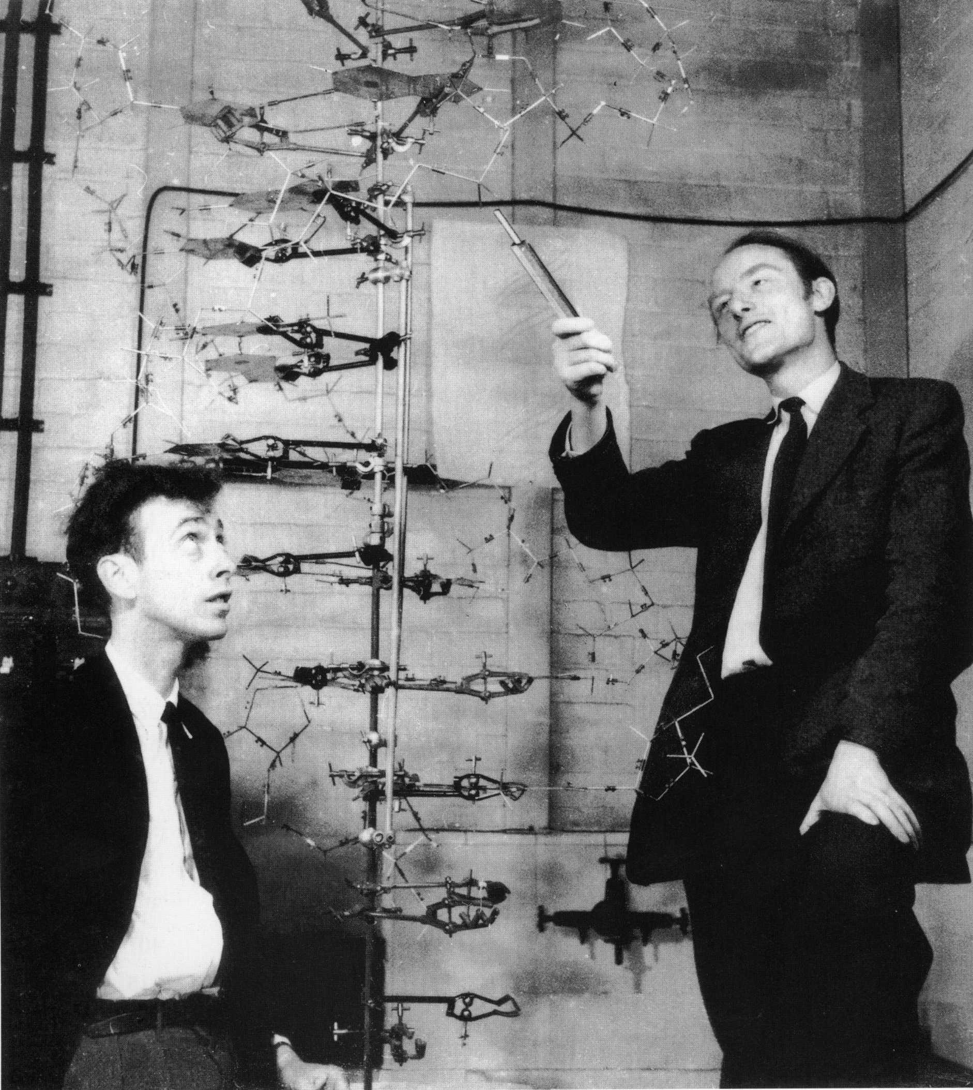
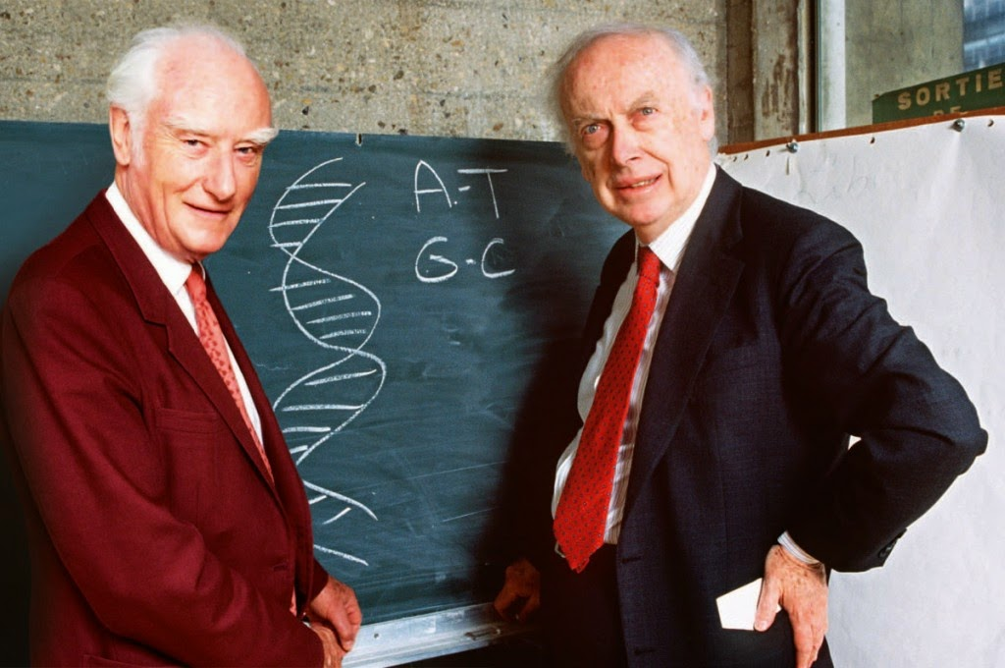
DNA was first isolated by Friedrich Miescher in 1869
Its molecular structure was first identified by James Watson and Francis Crick at the Cavendish Laboratory within the University of Cambridge in 1953

Slide 4
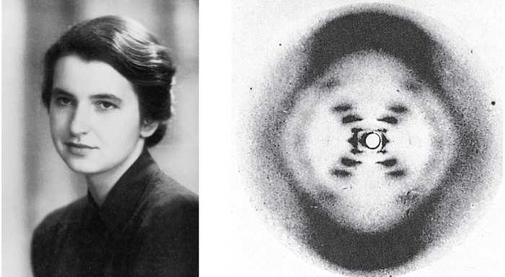
Model-building efforts were guided by X-ray diffraction data acquired by Raymond Gosling who was a post-graduate student of Rosalind Franklin

Slide 5
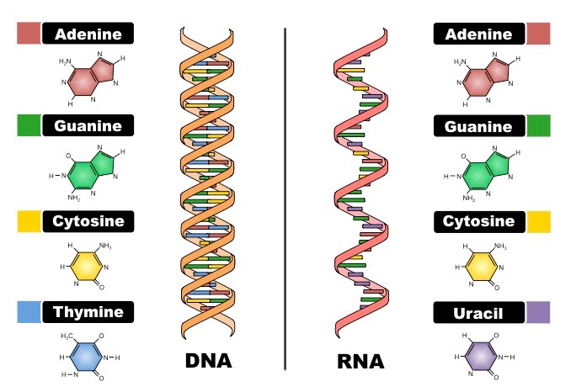
DNA & RNA

Slide 6
DNA & RNA
DNA and ribonucleic acid (RNA) are nucleic acids; alongside proteins, lipids and complex carbohydrates (polysaccharides), they are one of the four major types of macromolecules that are essential for all known forms of life.

Slide 7
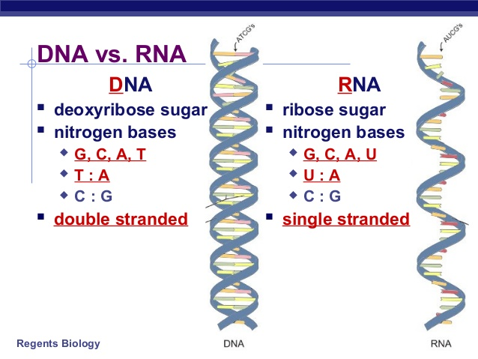

Slide 8
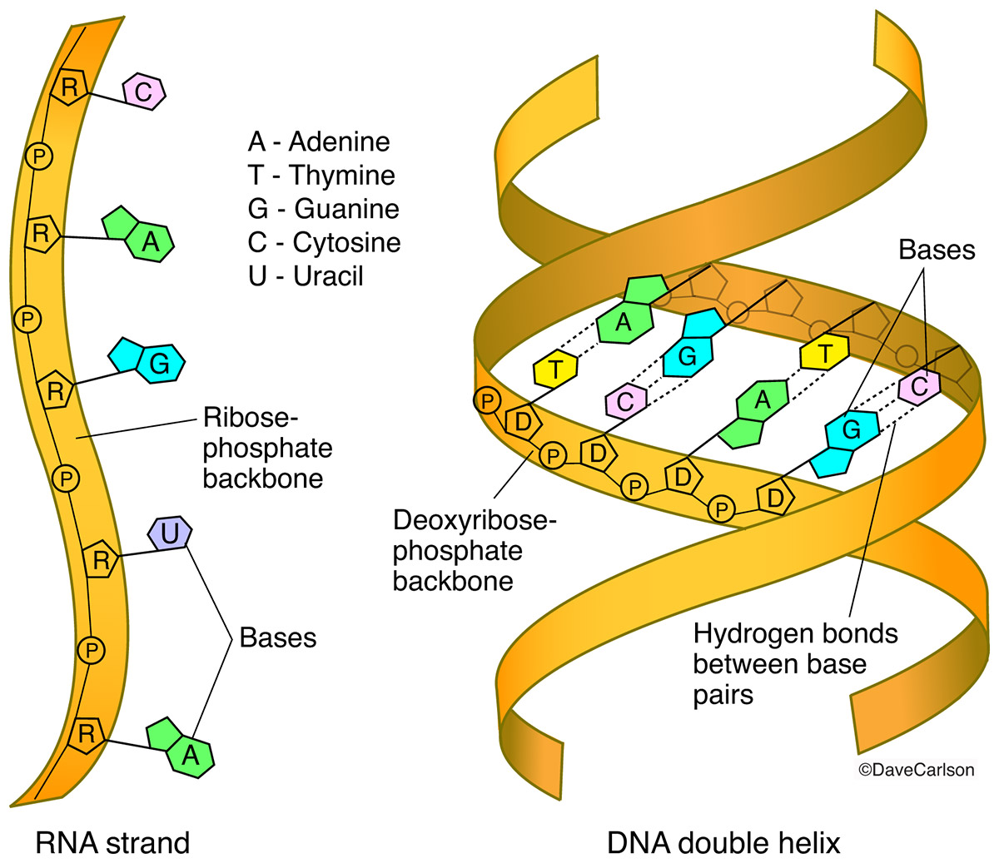

Slide 9
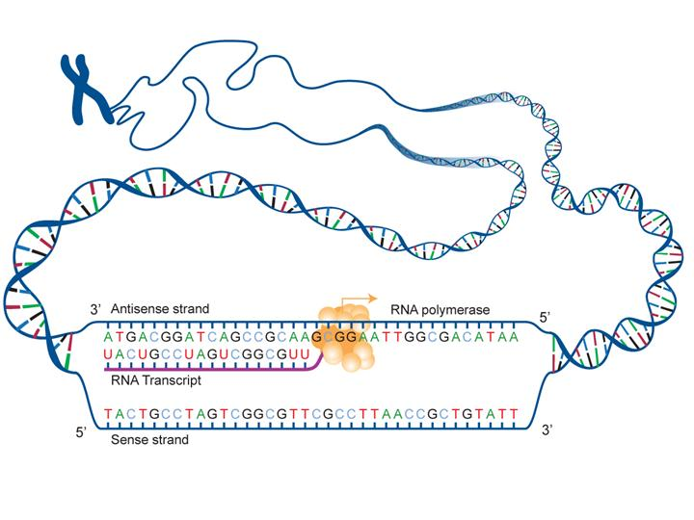
Most DNA molecules consist of two biopolymer strands coiled around each other to form a double helix. The two DNA strands are called polynucleotides since they are composed of simpler monomer units called nucleotides

Slide 10
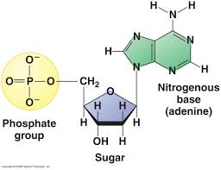
Each nucleotide is composed of phosphate group and one of four nitrogen-containing nucleobases sugar called deoxyribose:
Cytosine [C]
Guanine [G]
Adenine [A]
Thymine [T]

Slide 11
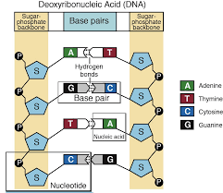
The nucleotides are joined to one another in a chain by covalent bonds between the sugar of one nucleotide and the phosphate of the next, resulting in an alternating sugar-phosphate backbone.
A = T
C = G

Slide 12
The nitrogenous bases of the two separate polynucleotide strands are bound together, according to base pairing rules (A with T and C with G), with hydrogen bonds to make double-stranded DNA.

Slide 13
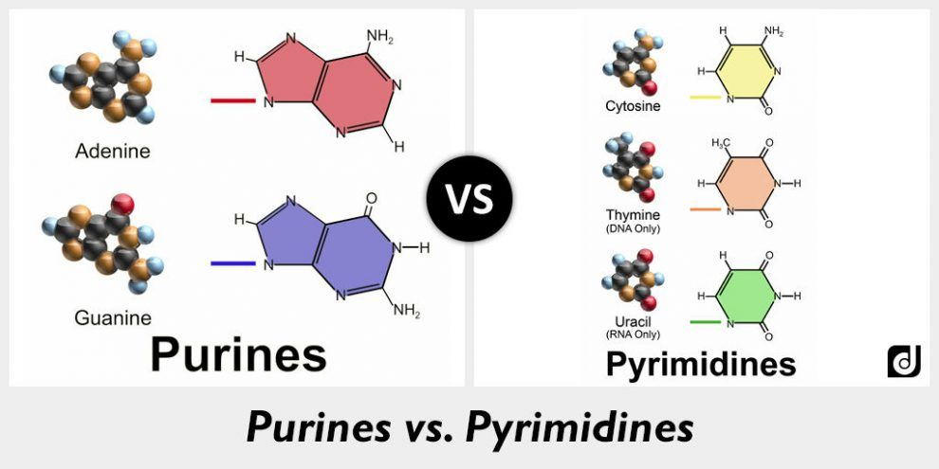
The complementary nitrogenous bases are divided into two groups:
Pyrimidines thymine and cytosine
Purines adenine and guanine

Slide 14


Slide 15


Slide 16

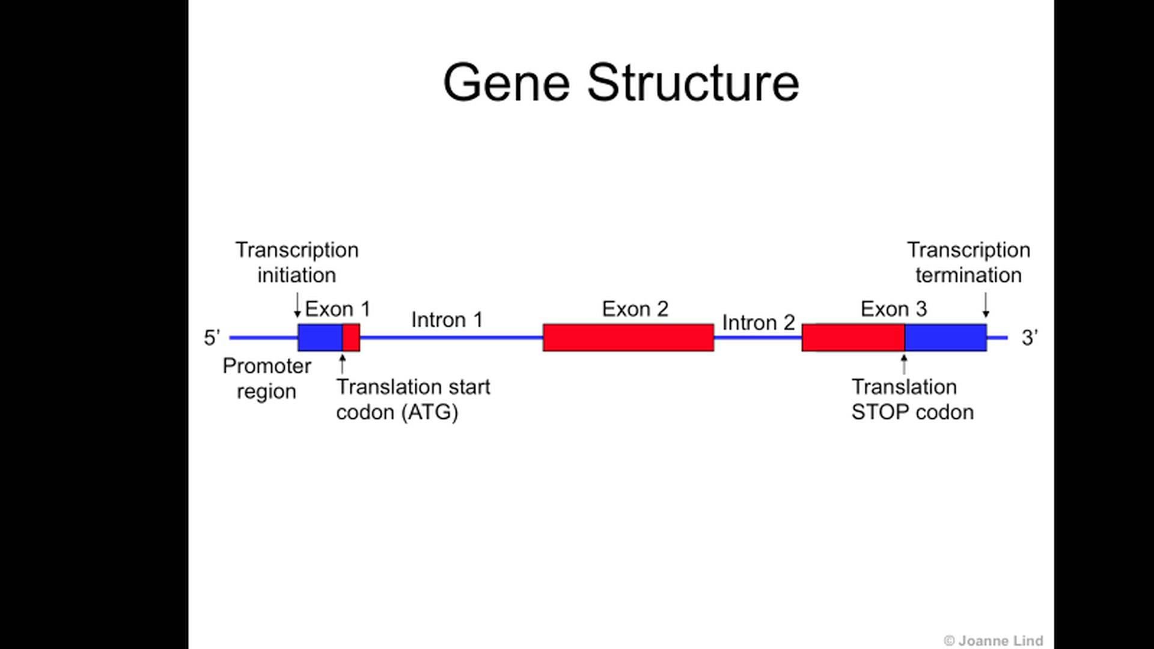
Both strands of the double-stranded structure DNA stores biological information
The DNA backbone is resistant to cleavage and it consists of major and minor groove
The DNA is consists of genes which is a sequence that codes for a
functional molecule.
Every gene consists of exon and intron

Slide 17
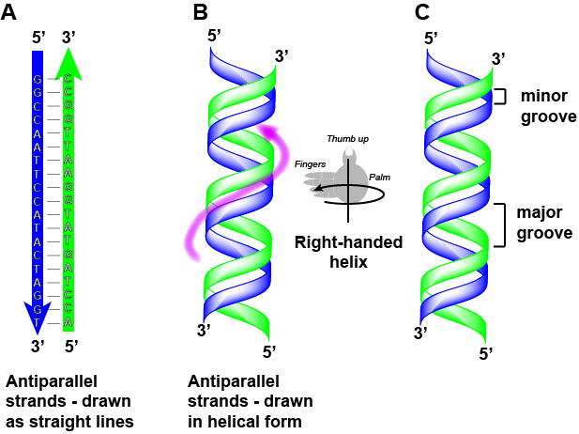
The two strands of DNA run in opposite directions to each other and are thus antiparallel

Slide 20

Any Question?

